Slide 1
Explicit Spotify Song Classification
David Chan

Slide 2
Purpose
Create a model to determine whether a song is explicit based off some features from Spotify’s API for future songs
Name
Artist(s)
Album
Energy
Valence
Tempo
Duration
Time Signature
Release Year
Notes:
Not all explicit songs are listed as explicit when uploaded
Energy is a measure from 0.0 to 1.0 and represents a perceptual measure of intensity and activity. Typically, energetic tracks feel fast, loud, and noisy. For example, death metal has high energy, while a Bach prelude scores low on the scale. Perceptual features contributing to this attribute include dynamic range, perceived loudness, timbre, onset rate, and general entropy.
Valence is a measure from 0.0 to 1.0 describing the musical positiveness conveyed by a track. Tracks with high valence sound more positive (e.g. happy, cheerful, euphoric), while tracks with low valence sound more negative (e.g. sad, depressed, angry).

Slide 3
Data Set Information
Songs from between 1908 to 2020
106162 albums
165365 artists or groups of artists
Approximately 7% of these songs are explicit
Notes:
Artists:
- Mariah Carey is different from Mariah Carey and Whitney Houston

Slide 4
Train-Test Splits, Accuracy, and Area Under ROC
80-20
Accuracy : 96.77%
Test Area Under ROC: 98.31%
75-25
Accuracy : 96.74%
Test Area Under ROC: 98.28%
70-30
Accuracy : 96.74%
Test Area Under ROC: 98.22%
Notes:
#Model 1 80-20 split
#Accuracy : 0.9676762048130143
#Training Area Under ROC: 0.9992808974017898
#Test Area Under ROC 0.9831225938810771
#Model 2 75-25 split
#Accuracy : 0.9674617074378462
#Training Area Under ROC: 0.9993084178588645
#Test Area Under ROC 0.982823692357705
#Model 3 70-30 split
#Accuracy : 0.9673963863521301
#Training Area Under ROC: 0.9993391035377046
#Test Area Under ROC 0.9821757322179495

Slide 5
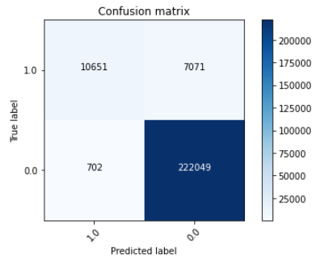
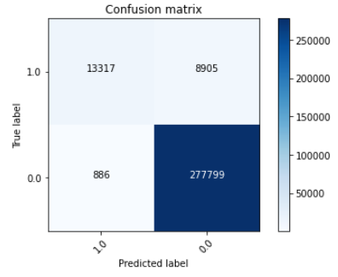
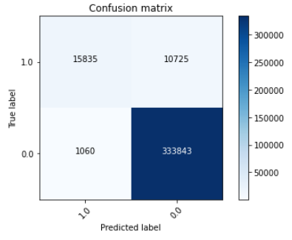
Results
Notes:
80-20
Accuracy : 0.9676762048130143
Precision: 0.601004401
75-25
Accuracy: 0.9674617074378462
Precision: 0.599270993
70-30
Accuracy : 0.9673963863521301
Precision: 0.596197289

Slide 6
Conclusion
Model “works”
Accurate but not precise
Future experiment requirements
Data set
Features used
Notes:
Training set might not have had enough for determining whether a song was explicit or not.
Features limited to using only ones that are from music itself
- Not using energy, valence, etc. from Spotify

